Slide 1


Social Buzz

Slide 2


Today's Agenda
Project recap
Problem
The Analytics team
Process
Insights
Summary

Slide 3

Social Buzz: Founded in 2010, this San Francisco-based social media platform, emphasizing content over user identity, boasts 500 million monthly active users, seeking external expertise for an imminent IPO, scalable growth, and big data management.
Accenture's Initiative at Social Buzz:
Embarking on a 3-month collaboration, Accenture aims to showcase our expertise and value to Social Buzz. Our focus includes: - An audit of their big data practice - Recommendations for a successful IPO - An analysis of their content categories that highlights the top 5 categories with the largest aggregate popularity
Project Recap

Slide 4

Problem
The team is struggling with too much data because there are now over 500 million active users. It's a big challenge that needs smart ways to handle all this information.

Slide 5



Abhas Jaiswal (Data Analyst)
The Analytics team
Marcus Rompton
(Senior Principle)
Andrew Fleming
(Chief Technical Architect)

Slide 6
PROCESS
1
DATA UNDERSTANDING
2
DATA CLEANING
3
DATA MODELLING
4
DATA ANALYSIS
5
UNCOVERING INSIGHTS

Slide 7

Insights
TOP 5 CONTENT CATEGORIES BY REACTION SCORE
NUMBER OF UNIQUE CATEGORIES
MOST POPULAR CATEGORY SCORES BY SENTIMENT

Slide 8
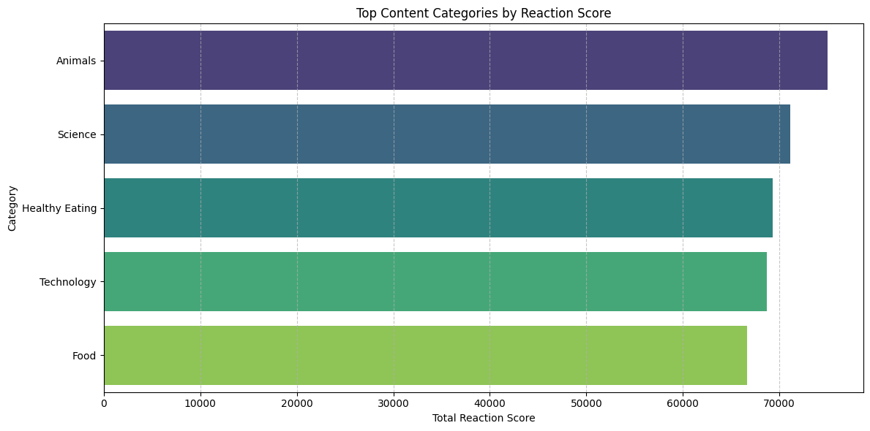
TOP 5 CATEGORIES

Slide 9
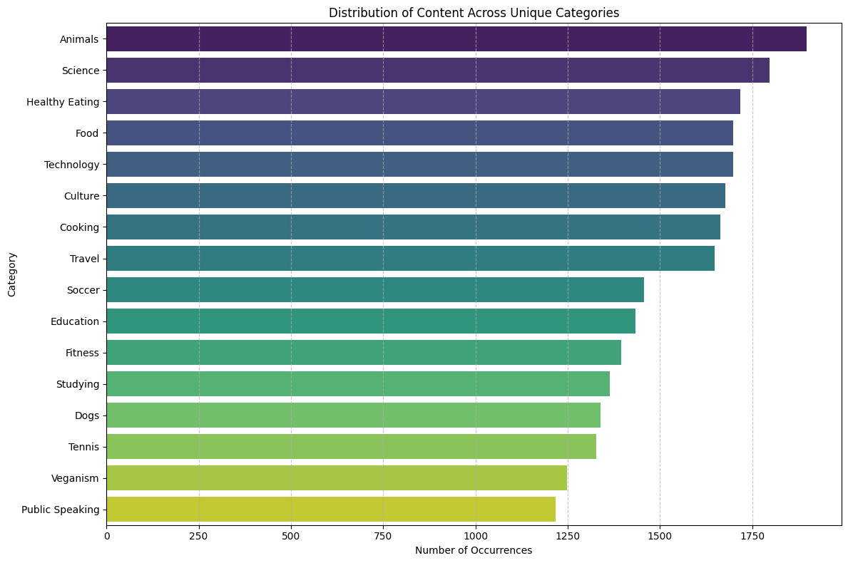
2. NUMBER OF UNIQUES CATEGORIES

Slide 10
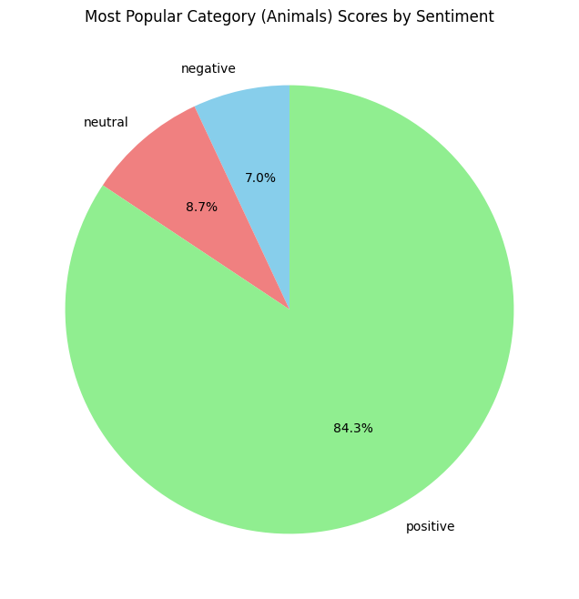
3. MOST POPULAR CATEGORY SCORES BY SENTIMENT

Slide 11

Top Content Categories: The top five content categories that have captured the audience's attention are Animals, Science, Healthy Eating, Technology, and Food. These categories resonate strongly with our user base.
Summary
Diversity in Categories: There are diverse range of content, with a total of 16 unique categories. This diversity highlights the broad spectrum of interests and preferences within our user community.
Most Popular Content Category - Animals: Our most popular content category is Animals. This category not only attracts the highest engagement but also evokes overwhelmingly positive sentiments among our users, with 84.3% expressing positivity. Additionally, 7.0% have negative sentiments, and 8.7% remain neutral.

Slide 12
Thank you!
ANY QUESTIONS?

